Slide 1
Python Chatbot Project
A Python-based Chatbot using Tkinter and NLP
By: ANKIT KUMAR

Slide 2
Introduction
This project is a Python-based chatbot using Tkinter for GUI and NLP for answering questions.
It has two modes:
1. Answer Mode (answers Python-related questions)
2. Quiz Mode (asks Python quizzes and tracks score).

Slide 3
Project Features
- GUI-based chatbot using Tkinter
- NLP-powered question-answering using Sentence Transformers
- Switch between Answer and Quiz mode
- Score tracking in Quiz mode
- Chat history saving feature
- Uses Cosine Similarity for question matching

Slide 4
Technologies Used
- Python
- Tkinter (for GUI)
- Sentence Transformers (NLP)
- JSON (for storing questions)
- PyTorch (for embeddings)
- Random module (for quizzes)
- datetime & time (for timestamps)

Slide 5
How It Works
User enters a question in Answer Mode
The chatbot uses NLP (Sentence Transformer) to find the best matching answer
In Quiz Mode, the chatbot asks a random question and validates the user’s response
The user can switch modes, save chat, or check scores
GUI updates in real-time with chat messages and scores

Slide 6
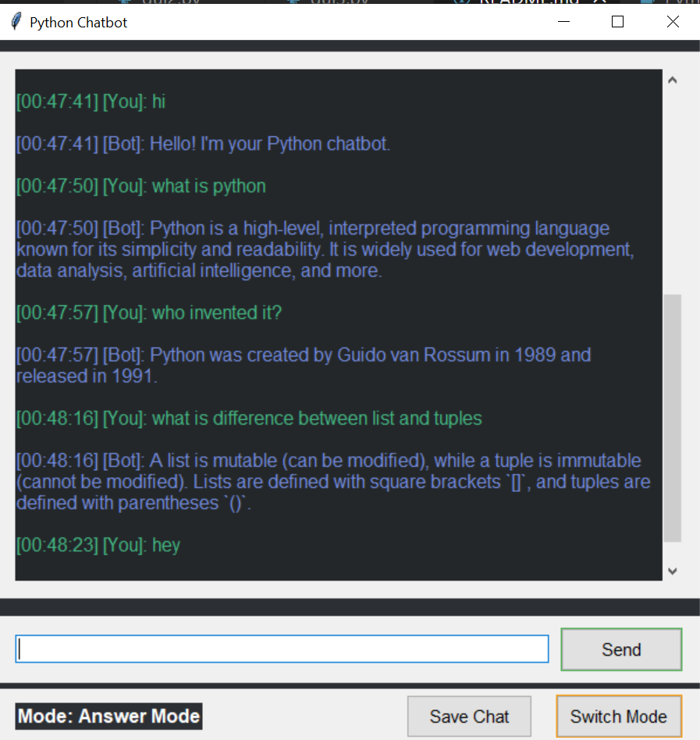
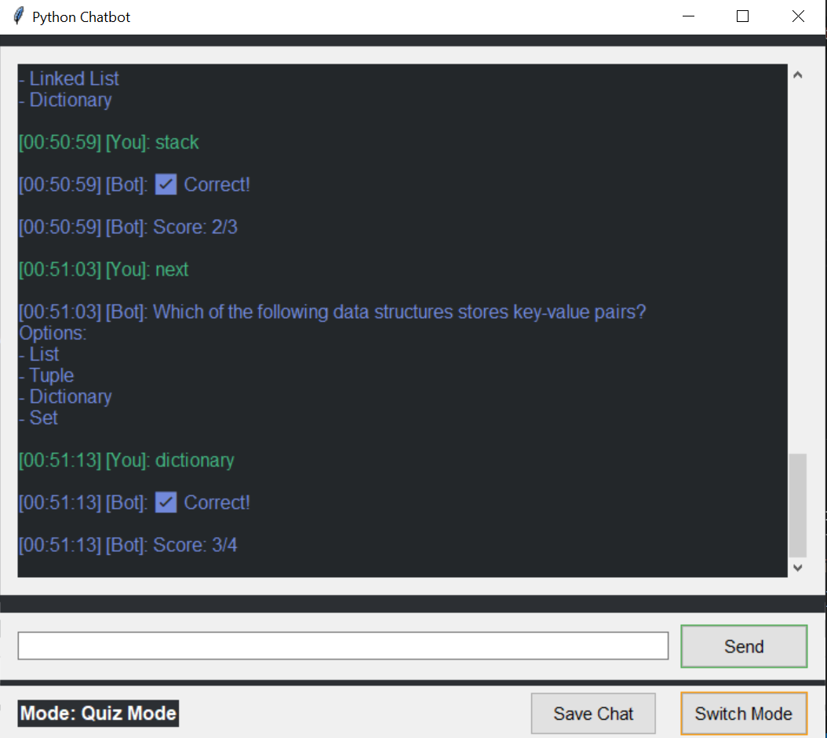
Project Screenshots

Slide 7
Future Enhancements
- Improve NLP model accuracy with fine-tuning
- Deploy the chatbot as a web app
- Add more Python-related topics in Quiz Mode
- Introduce leaderboard for quiz performance
- Add voice input & response using Speech Recognition

Slide 8
Conclusion
This chatbot project demonstrates how Python, NLP, and Tkinter can be used to build an interactive chatbot.
It can answer Python-related questions and test user knowledge through quizzes.

Slide 9
Let’s go through code walkthrough and practical demo

